Slide 1
High-throughput and Adaptive Feedback Microscopy
Christian Tischer, Sabine Reither, Volker Hilsenstein, Beate Neumann, Rainer Pepperkok
Advanced Light Microscopy Facility, EMBL Heidelberg
Meyerhofstr.1, 69117 Heidelberg, Germany
High-throughput microscopy of siRNA treated cells has become a standard tool for discovering genes with roles in specific biological processes. However, conducting high-throughput microscopy experiments is still challenging as it puts high demands on sample preparation, microscopy, image and data analysis. Moreover, further characterization of the “hit genes” often requires demanding microscopic assays that are difficult to perform even in medium throughput. In this talk, I will outline the typical challenges occurring in high-throughput microscopy and discuss how dedicated microscope systems can help to tackle these challenges. In addition, I will describe how “adaptive feedback microscopy” allows scientist to perform highly complex microscopic assays in a fully automated manner, thereby enabling detailed and systematic further investigation of the identified “hit genes”.

Slide 2
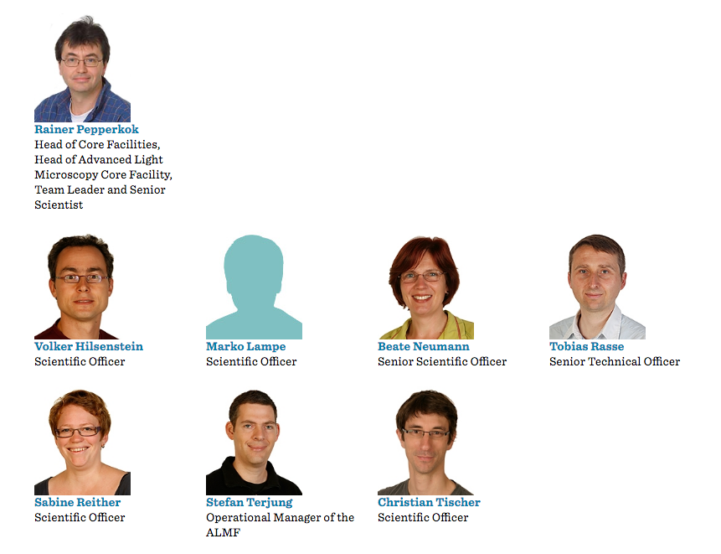




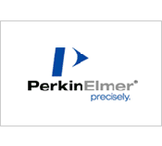
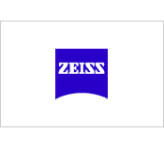
Advanced Light Microscopy Facility (ALMF) at EMBL Heidelberg
Headed by Rainer Pepperkok
Around 30 microscope systems
Since Serving EMBL scientists and world-wide visitors.

Slide 3
High-throughput Screening Microscopy
“Primary” screen
Protein knockdown by siRNA
Monitor perturbation of biological process in microscopy assay
Biological process
Protein localization dynamics
Which proteins?
Protein-protein
Interaction dynamics
“Secondary” screen
“Secondary” screen
Notes:
You have an assay that tells you whether the process of interest is working and then you look in the presence of siRNAs whether the process is still working.

Slide 4
HTM Screening Projects at ALMF
Name Project List with Picturescel

Slide 5
Things you may pay attention to when acquiring a new high-throughput screening system

Slide 6

Multi-color Imaging Modalities
Slowest, no crosstalk
Sample
Sample
Halogen light source
fixed
Filter cubes
hundreds of milliseconds
LED
Switching
milliseconds
Multi-band dichroic fixed
Emission filter wheel tens of milliseconds
Faster, no crosstalk
Sample
LED
Switching
milliseconds
Multi-band dichroic fixed
Fastest, but potential crosstalk
Multi-band emission filter
fixed

Slide 7
Auto-focus modalities
“Software” autofocus
“Hardware” autofocus

Slide 8
Temperature stability
Add movie

Slide 9
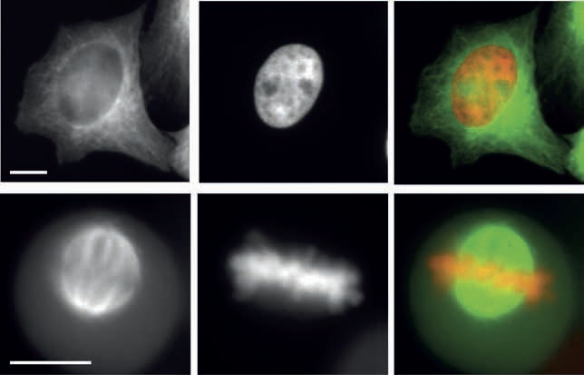
Running costs
GFP-Tubulin
DNA (Hb2-mCherry)
Merge
Picture multi-well plate
Prices for glass-bottom
And plastic-bottom
Interphase
$$$
Mitosis
Celldiscoverer 7
logo
Fig. 2: Double colour imaging in plastic cell culture plates.
HeLa-Kyoto cell stably expressing H2B-mcherry and GFP-tubulin were cultured in a
plastic cell culture plate from NUNC, fixed and subsequently imaged using a 20x/0.75NA
objective with a magnification changer 2. (A,D) GFP-tubulin, (B,E) H2B-mcherry, (C,F)
overlay image (GFP-tubulin shown in green and H2B-mcherry in red). Scale bar 10 μm.
Todo: check effective NA=40x/0.75?

Slide 10
Things to pay attention to when acquiring a new high-throughput screening system

Slide 11
Things to pay attention to when acquiring a new high-throughput screening system

Slide 12
Things to pay attention to when acquiring a new high-throughput screening system

Slide 13
Things to pay attention to when acquiring a new high-throughput screening system

Slide 14
Edge effects

Slide 15
Autofocus CellDiscoverer 7
Find Surface
Focus Hold
Focus every time-point and position

Slide 16
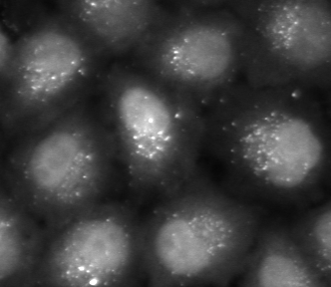
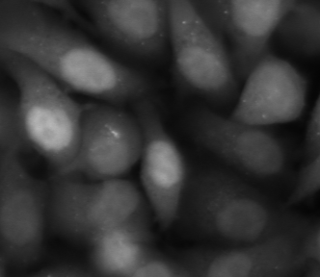
Autophagosome screen
Treatment A
Treatment B
In principle, the total intensity inside all dot-like structures
in each cell is proportional to the amount of protein recruited
to autophagosomes in this cell.

Slide 17
Acquisition modalities: confocal
Z-stack with point scanning confocal
Z-stack with spinning disc confocal
10 micrometer
z
Good option, if available: on-the-fly z sum projection during acquisition
Save ~10x disc space
Simplify image analysis workflow (2-D only)
Typically too slow for high-throughput screening

Slide 18
Acquisition Modalities: Widefield
Widefield NA0.3
Widefield NA0.9
Good option, if available: on-the-fly deconvolution and z sum projection during acquisition
Save ~10x disc space
Greatly simplify image analysis workflow (2-D only, no deconvolution)

Slide 19
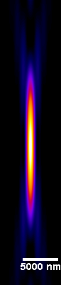
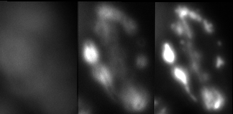
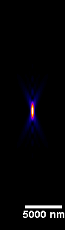
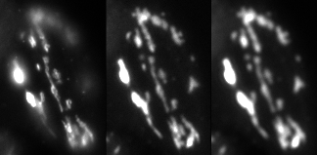
Low NA Fluorescence Imaging
HeLa cell, Golgi-GFP
dz = 1 micrometer
NA 0.3
NA 0.9
z
y
Celldiscoverer 7
logo
x
z
NA 0.35
NA 0.26
x
NA 0.8

Slide 20
Advice
High-throughput screening microscopy is not about pretty 3-D pictures but about fast and manageable measurements.
Typical: 100x Oil lens confocal z-stacks => Single plane 20x Air lens

Slide 21
Multi-well Transmission Imaging
Image without shadows
Image with shadows

Slide 22
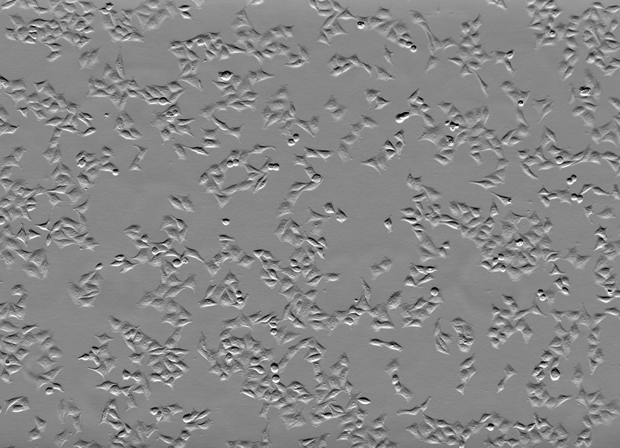
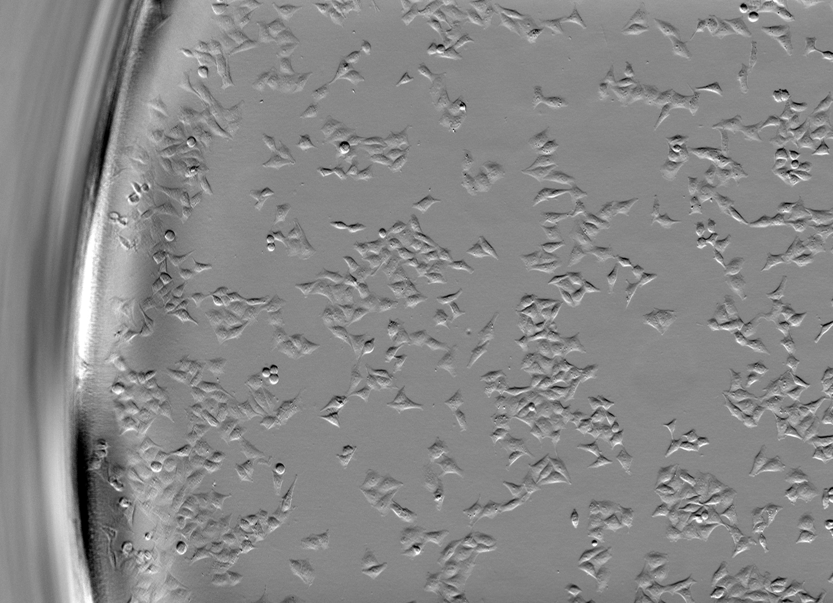
Low NA Transmission Imaging
Condenser Aperture
Celldiscoverer 7
logo
Image without shadows
Image without shadows

Slide 23
What to measure
Mean vs Sum
Cell cycle example

Slide 24
Secondary Screens

Slide 25
What to measure
Mean vs Sum
Cell cycle example

Slide 26



Intelligent Microscopy [Conrad et al.] Adaptive Feedback Microscopy [Tischer et al.] Smart Microscopy [Huisken et al.] Open Application Development (OAD) [Zeiss]
Sent new microscope settings
Analyze data to derive adapted microscope settings
Todo:
add references
Look for more synonyms

Slide 27
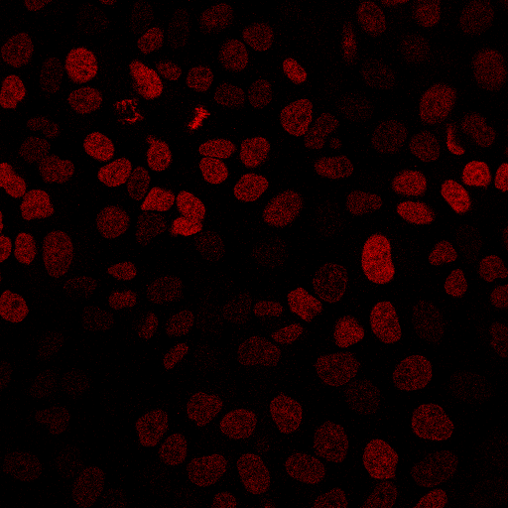
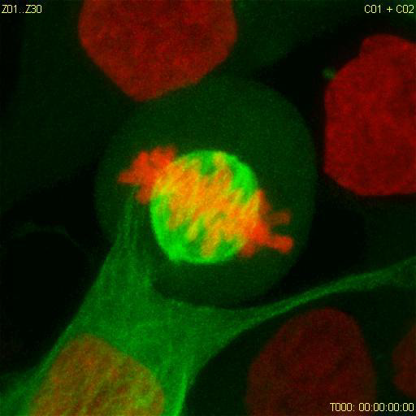
High-resolution Adaptive Feedback Time-lapse Imaging of Mitosis
- Move to next grid position. - Acquire low-zoom, single plane, single channel image
Todo:
make images gray-scale
Add microscope icon
x, y
Microscope:
- Move to x,y - Acquire high-zoom, multi plane, dual color, time lapse data
x=150 y=80
Automated analysis:
Mitotic cell coordinates

Slide 28

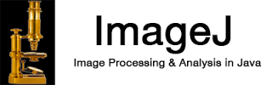
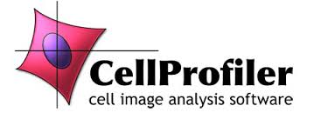
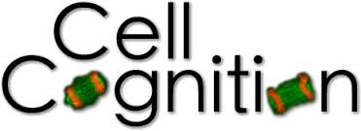
ZEN Black
Logo, LSM510 logo
Todo:
add references
Look for more synonyms
(1) Rabut and Ellenberg, Automatic real-time three-dimensional cell tracking by fluorescence microscopy. J. Microscopy, 2004

Slide 29

ZEN Blue
ZEN Blue
Todo:
add references
Look for more synonyms
(1) Rabut and Ellenberg, Automatic real-time three-dimensional cell tracking by fluorescence microscopy. J. Microscopy, 2004

Slide 30
Multi-step Adaptive FRAP Microscopy
Zeiss
LSM780
Visual Basic
ImageJ Analysis
In this way several hundreds of recovery data sets can be automatically acquired in an overnight experiment, thus drastically increasing the data significance
compared to manual data acquisition where at best several tens of useful datasets
can be acquired in the same amount of time.

Slide 31
Adaptive FCS Microscopy

Slide 32
Automated Immersion System
Both FRAP and FCS typically require high NA imaging => Objective Lenses with Immersion

Slide 33
Image analysis, quality control and statistics

Slide 35
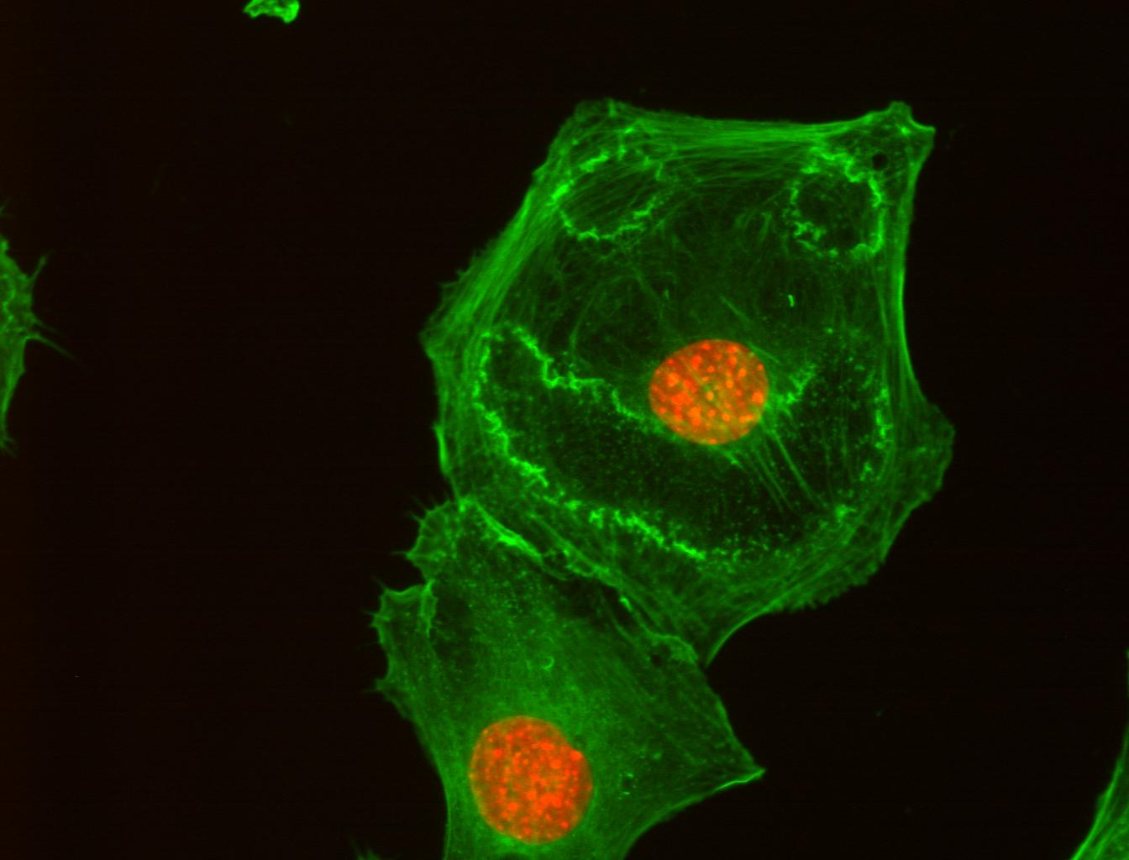
Acknowledgements
ALMF team:
Beate Neumann
Sabine Reither
Volker Hilsenstein
Yury Belyaev
Stefan Terjung
ALMF alumni
Christian Conrad
Jutta Bulkescher
FCS:
Malte Wachsmuth
Frank Sieckmann (Leica)
Zeiss LSM780 automation:
Gwen Rabut, Annelie Wuensche, Antonio Politi
Jan Ellenberg
Rainer Pepperkok
Green: actin cytoskeleton
Red: nucleus
Cells treated with PDGF

Slide 38
Adaptive Feedback Microscopy using ZEISS products
Microscope Examples | Zeiss Software | Open Application Development Modality | Image Analysis Modalities
LSM510 confocal (1) LSM780 confocal LSM880 confocal | ZEN Black | Visual Basic scripting with macro recording | Visual Basic or external software
LSM800 confocal CellDiscoverer 7 widefield | ZEN Blue | Python scripting with macro recording | ZEN Blue interal image analysis or external software
(1) Rabut and Ellenberg, Automatic real-time three-dimensional cell tracking by fluorescence microscopy. J. Microscopy, 2004

